Slide 1
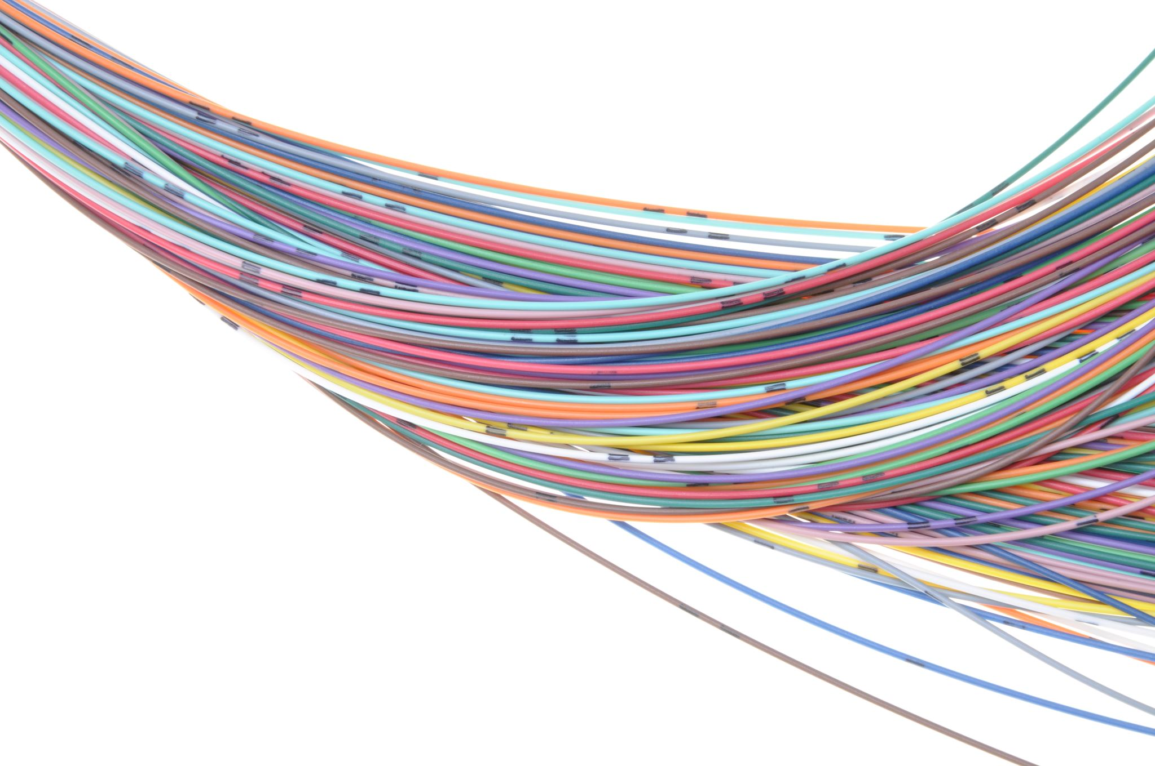
IMPROVEMENT INNOVATION AND DECISION MAKING
BUSINESS CASE
Project AI
www.tritekconsulting.co.uk

Slide 2
Table Of Contents
Mandate
Executive Summary
Reason
Business Options
Market Research
Timescales
Costs
Investment Appraisal
Major Risk
Recommendation

Slide 3
Mandate
The aim of this project is to modernize Tritek's LMS profile for the candidates, to make it more current with the latest features in the market and relevant for our users. This will be in line with making the interface and interaction of users to be seamless.

Slide 4
Tritek consulting is a leading consultancy firm that has entrusted itself as a trusted partner in helping individuals transition into the dynamic world of technology.
One of the key features that sets Tritek apart is its Learning Management System (LMS) platform. However, to stay competitive in the rapidly evolving service industry, Tritek recognizes the need to modernise its LMS profile
This project will focus on modernizing Tritek’s LMS profile, making it more current and relevant for its user by incorperating the latest features in the market and ensuring a seamless interface.One of the key benefit is to make Tritek remain at the frontline of the tech industry.
EXECUTIVE
SUMMARY
The return on investment (ROI) expected is 20% increase in profit if the project is completed. A SWOT, PESTLE and Competitors Analyses have been carried out to highlight the viability of the project.
The proposed methodology for project delivery is WAGILE. The allocated budget is £40,000, with a timeline of 10weeks (7 weeks for the project and 3 weeks for the build-up) with no tolerance

Slide 5
BUSINESS PROBLEM
The current performance tracking system on the platform is not robust, making it difficult for candidate to track their performance and work progress
One potential problem could be the integration of these new features into the existing system, ensuring they work seamlessly without disrupting current operations.
Candidates encounter difficulties in exploring the platform, leading to decreased engagement and outdated account management system affects candidate’s satisfaction and retention, restricting user autonomy.

Slide 6
A modern LMS profile serves as a gateway allowing educational content to reach learners globally which will in the end foster user retention.
PROJECT VISION
incorporating the latest features in the market, will make Tritek a frontliner in the tech industry. With a well-planned project timeline and a dedicated budget, Tritek is poised to successfully achieve its goal of modernizing its LMS profile and providing an interactive platform for its candidates

Slide 7
Business Options
Option 1: Do Nothing
candidates who access Tritek LMS profile get to perform their task successfully but find it quite tedious and time consuming. Tritek Consulting ltd may decide to do nothing or maintain the study scope.
Benefits
No cost of the new project will be incurred as no action will be taken.
Skepticism on the proposed change with respect to the impact it may have on the current lms profile is avoided.
The platform will run uninterrupted.
Disbenefits
‘Doing Nothing’ will
increase candidates and users frustration and dissatisfaction over time.
give competitive advantage to competitors of Tritek Consulting ltd.
cause candidates and users to spend less time on the platform.
reduce the rate of referrals for Tritek Consulting ltd.

Slide 8
Business Options
Option 2: Do Minimum
Doing minimal means Tritek Consulting Ltd acknowledges the need to modernize the current lms profile but cannot handle the change fully at the time of the business case therefore doing the minimum by rearranging the icons and features, deleting and merging some functions have been recommended. Like merging Enrolled courses, active course and completed courses together under “my learning”
Benefits
Reduced cost of development as cost to be incurred in choosing this option will not be as much as the 'do something' option.
Usage of the lms platform will not be interrupted.
Candidates and users dissatisfaction will be reduced to the barest minimum.
Dis-benefit
The lms profile will still not be seamless and not meet current market standards.
The lms platform will still lack a touch of modernization that the project aims to achieve i.e introduction to new features that captivates candidates and users.
Tritek Consulting ltd will not have the competitive edge in the market as modern features will be absent on the lms profile.

Slide 9
Business Options
Option 3: Do Something
The "Do something" option will ensure that a new Tritek LMS profile is developed which will not only be seamless and user friendly but will be modernized with the latest service features in the market on display to make the interface captivating and interactive for candidates and users.
Benefits
Improve candidate and user satisfaction.
The modernized platform ensures that the lms profile meets industry standards.
The new Tritek lms profile will make the interface and interaction seamless for users.
The new and latest features will give Tritek Consulting ltd the competitive advantage in the tech industry.
Dis benefits
Cost incurred in mobilizing a competent team to develop this project.
There may be future cost of updating and maintaining the newly developed lms profile.

Slide 10
MARKET RESEARCH
SWOT ANALYSIS
STRENGTHS Streamlined training delivery reducing downtime Provides detailed insights into learner performance and engagement. Resource Accessibility | WEAKNESSES The poor interface makes the user journey difficult. Complex Implementation Deployment and customization may demand considerable time and resources. Scalability Concerns
OPPORTUNITIES Personalized Learning Utilizing learning data to enhance course effectiveness and performance outcomes. Mobile Integration | THREATS Increased market saturation might lead to pricing pressure and diminishing differentiation Cybersecurity Vulnerabilities Regulatory Compliance

Slide 11
PESTLE ANALYSIS
PESTLE | DESCRIPTION
POLITICAL | Imposition of security roles and permission Compliance to government policy opens LMS more flexible, accountable and user-friendly
ECONOMIC | Tritek’s pricing models impact economic accessibility, considering diverse global economic conditions.
SOCIAL | Adoption and acceptance of modern remote and hybrid learning Tritek’s global reach necessitates adapting content to diverse cultures and languages.
TECHNOLOGICAL | The continuous evolution of learning technologies requires Tritek’s LMS to stay technologically agile Seamless adaptability to emerging friends in Tritek.
LEGAL | Data protection laws and policies Intellectual property rights and accreditation of courses ensure legal recognition and protection.
ENVIRONMENTAL | Tritek’s environmental impact includes the energy consumption of its data centers, prompting considerations for sustainability. The learning platform may adopt eco-friendly practices to align with growing environmental consciousness

Slide 12
MARKET RESEARCH
COMPETITOR ANALYSIS
TRITEK | CREST AGILE | 10ALYTICS | IT ONLINE LEARNING
Strength Strong Online presence on social media. Affordable price point and easy enrollment process. Excellent quality course offerings, materials and training videos Weakness Limited Brand recognition compared to established competitors. | Strength Emerging brand in the tech space with speciality in Agile Methodology User friendly interface which makes for easy navigation. Weakness Less known brand. Cost to enrol in programmes is high | Strength Presence of strong brand name in tech learning sector. User friendly and aesthetically pleasing interface Weakness Limited Brand recognition compared to established competitors | Strength Established level of courses from beginner to advanced Collaborations with industry leading experts to offer accredited certifications. Weakness Price of courses are expensive and overpriced. Boring and long training video contents.

Slide 13
TIMESCALE
PHASE | DURATION | START DATE | END DATE
INITIATE | 27 DAYS | 21/11/23 | 12/01/24
DEFINE | 6 DAYS | 12/01/24 | 22/01/24
EXECUTE | 17 DAYS | 08/01/24 | 14/02/24
CLOSURE | 5 DAY | 14/02/24 | 18/02/24

Slide 14
COST
The allocated budget for this project is £40,000 over a 10-week period (7 weeks for the project timeline and 3 weeks for the build-up), with no tolerance. Most of this sum will go toward paying developers and internal stakeholders (Project team). The project team is responsible for ensuring that total costs do not exceed the client-agreed sum as stated during the meeting with the Sponsor.
PROJECT AI
STAGE | NUMBER OF DAYS | COST (£)
INITIATE | 27 | 13,640
DEFINE | 6 | 4,400
EXECUTE | 17 | 20,800
CLOSURE | 1 | 640
TOTAL | 51 | 39,480

Slide 15
Investment Appraisal
Technique: Payback Period | After Project Completion
Assuming Tritek recruits 200 candidates every 2 months. Each candidate pays £400 as a subscription fee. After the completion of this project it is expected that there would be a high demand. Tritek should be able to recruit 150/month because of this high demand. Assuming before this project was initiated, Tritek had 1200 candidates/year and gross income of £480,000. We estimate a 20% profit from the subscription which is £96000 . | After this project is completed, Tritek is projected to have 1800 candidates/year and gross income of £720,000. We estimated a 20% profit from the subscription which is £144,000. It is expected that there should be an exponential increase per year.

Slide 16
INVESTMENT APPRAISAL
The Investment Appraisal for this project has adopted the Net Profit Value (NPV) method. The NPV method provides the time value for money on investing the capital for the project. It is the most common Investment Appraisal method which is the sum of discounted net future cashflows for the project. It allows investors/stakeholders to make informed decision on their investment.
Important Data/Assumption for the Project NPV Calculation.
Investment Appraisal Period – 5 Years
Discount Factor (Source Gov.UK) – 3.50%
Cash Inflow - This has been calculated based on 10% annual sales growth rate and from estimation of Tritek’s revenue stream.
The Project Net Profit Value (NPV) Calculation.
The Net Present Value (NPV) for the project is £21,515.84.
Hence, NPV is greater than zero.
Year | Cash Inflow (£) | Discount Factor (3.5%) | Present Value (PV) (£)
0 | 40000 | 1.0000 | (40,000.00)
1 | 14450 | 0.9662 | 13,961.59
2 | 15895 | 0.9335 | 14,837.98
3 | 17585 | 0.9019 | 15,859.91
4 | 19344 | 0.8714 | 16,856.36
Total PV |  |  | 61,515.84
Net Present Value |  |  | 21,515.84

Slide 17
INVESTMENT APPRAISAL CONT’D
YEAR | PROFIT | CUMULATIVE PROFIT
0 | 96,000 | 96,000
1 | 144,000 | 144,000
2 | 288,000 | 432,000
3 | 576,000 | 1008000
Going by the table above, if Tritek invested £40,000 in this project and makes a profit of £144,000/year
i.e. £12,000/month, the payback period would be less than 4 months.
ROI = Amount Gained - Amount Spent
Amount spent
= (144000 - 96000) - 40000 = 0.2
40000 %ROI = 0.2 X 100
= 20% (Expected Percentage return on investment Y1)

Slide 18
MAJOR RISKS
RISK | DESCRIPTION | IMPACT ASSESSMENT | MITIGATION PLAN | OWNER
SPONSOR AVAILABILITY | Low requirement gathering due to the minimal time follow-up with the sponsor | This may affect the different stages of the Project and may affect the timeline | By setting up meeting with the sponsor and contacting them via all accessible channel of communication | PM
RESOURCE AVAILABILITY | Not having sufficient resources to complete tasks and meet deadlines. | This may affect the team’s ability to complete tasks on time and may also lead to available resource burnout. | All team members will be assigned a task and a follow up call to ensure that all members are engaged | TEAM MEMBERS
SKILL GAP | Disparity between skills among team members required on the project | This may cause slower task execution that may affect the project timeline | Members are being encouraged to watch their LMS videos and volunteer on project tasks | TEAM MEMBERS
TEAM MEMBERS | Poor communication among team members regarding meetings and tasks. | This may affect the quality and timeline of the project | All team members will be assigned a task in the form of a rota and follow-up pings to ensure that all members are engaged | TEAM MEMBERS

Slide 19
RECOMMENDATIONS
Regular update of the platform to make it more organised and user friendly,
Set up links on the home page for a seamless navigation by the user to ensure quick access to necessary information.
Incorporating tracking features to gain insight on the use the platform, by the candidates. This will guide Tritek to understand areas of interests and provide more relevant services.
Improving support services by introducing technical systems like the AI Chatbot to respond to FAQ and general enquiries in time.
Introducing a Two-Factor Authentication [2FA ]system to ensure safeguarding of data and candidate information. This promotes the overall integrity of the platform.

Slide 20
THANKS

